Slide 1
Welcome patriots!
New patriot
Summer Orientation

Slide 2
Counselor/ Academic Information

Slide 3
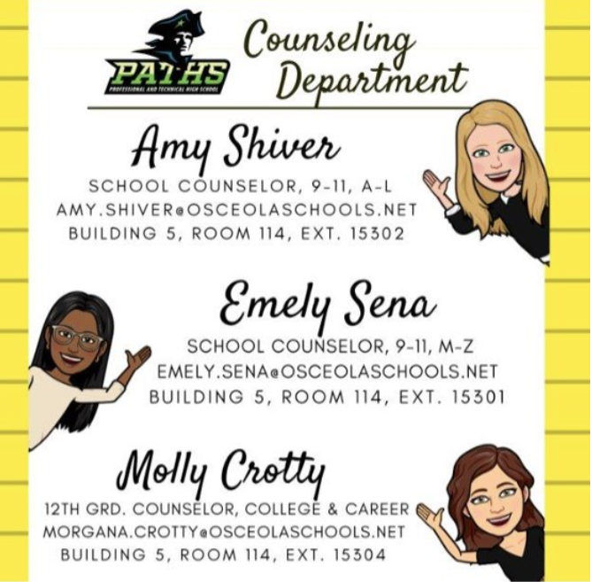
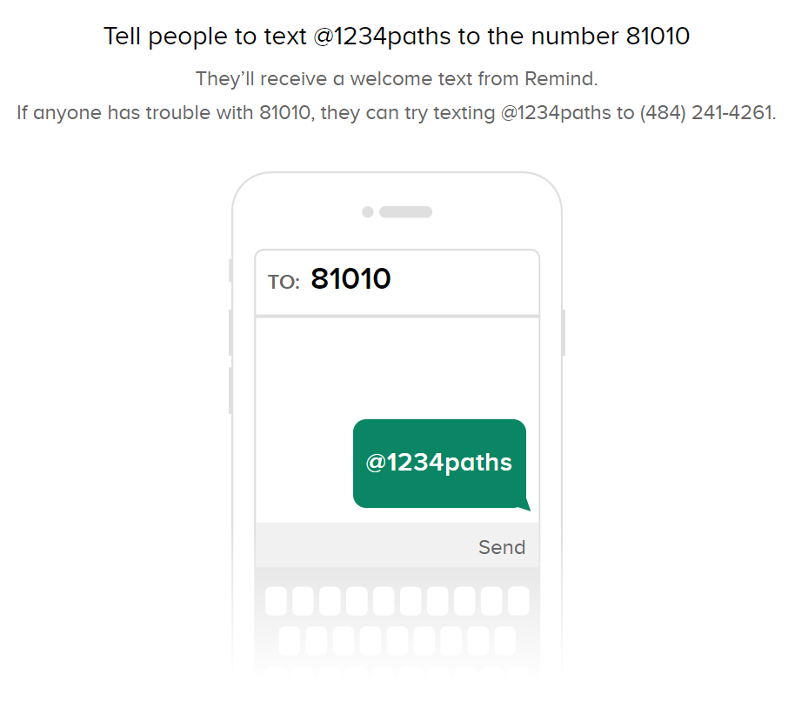
Stay Connected!
Student Remind:
@paths28
Parent Remind:
@1234PATHS

Slide 4
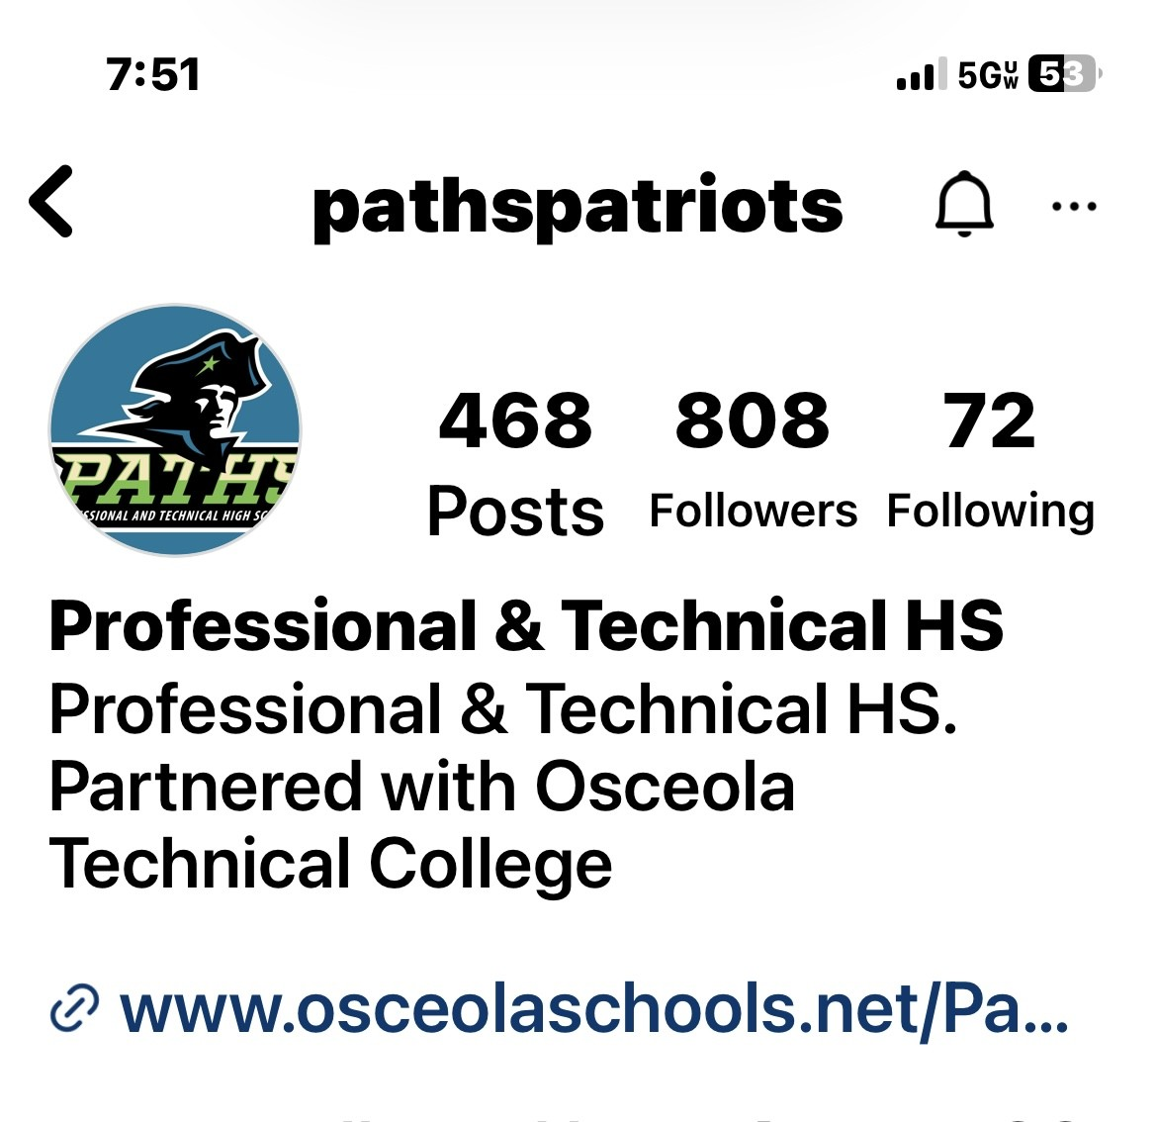
FACEBOOK
INSTAGRAM

Slide 5
Florida Graduation Requirements
24 Credits
4 English
4 Math (Including Algebra 1 and Geometry)
3 Science (Including Biology)
3 Social Studies (Including World & US History, Government & Economics)
1 Fine/Practical Art
1 PE
8 Electives (Including Financial Literacy)
2.0 or greater GPA (C average)
State Exams
Pass Algebra 1 EOC
Pass 10th ELA FAST exam
Take Geometry, Biology, US History EOC
Planning for College TIP:
World Language is not required for HS Graduation….BUT it IS required for College Admission and scholarships.
Need 2 consecutive years in the same language

Slide 6
Diploma Designations
Scholar Diploma Designation
Industry scholar Diploma Designation
2 Credits Higher Level Math
Algebra II, Statistics, or equally rigorous math course
2 Credits Higher Level Science
Chemistry or Physics and one equally rigorous science course
2 Credits in same World Language
1 Credit in AP, IB or DE course
Pass all EOC Exams: Geometry, Biology, US History
Earns one or more industry certifications
Biliteracy Seal
Earn 4 credits in the same language and pass FAST with a 4 or higher
OR
Pass AP Exam with 3 or higher

Slide 7
DIPLOMA DESIGNATION CONTINUED
PATHS, NeoCity, and OCSA will no longer have Valedictorian and Salutatorian Designations at Graduation.
We will honor all students who have an exceptional GPA:
Suma Cum Laude (Highest Honor) = 4.2 or higher weighted GPA
Magna Cum Laude (High Honor)= 4.0-4.199 weighted GPA
Cum Laude (with Honor)=3.8-3.999 weighted GPA

Slide 8
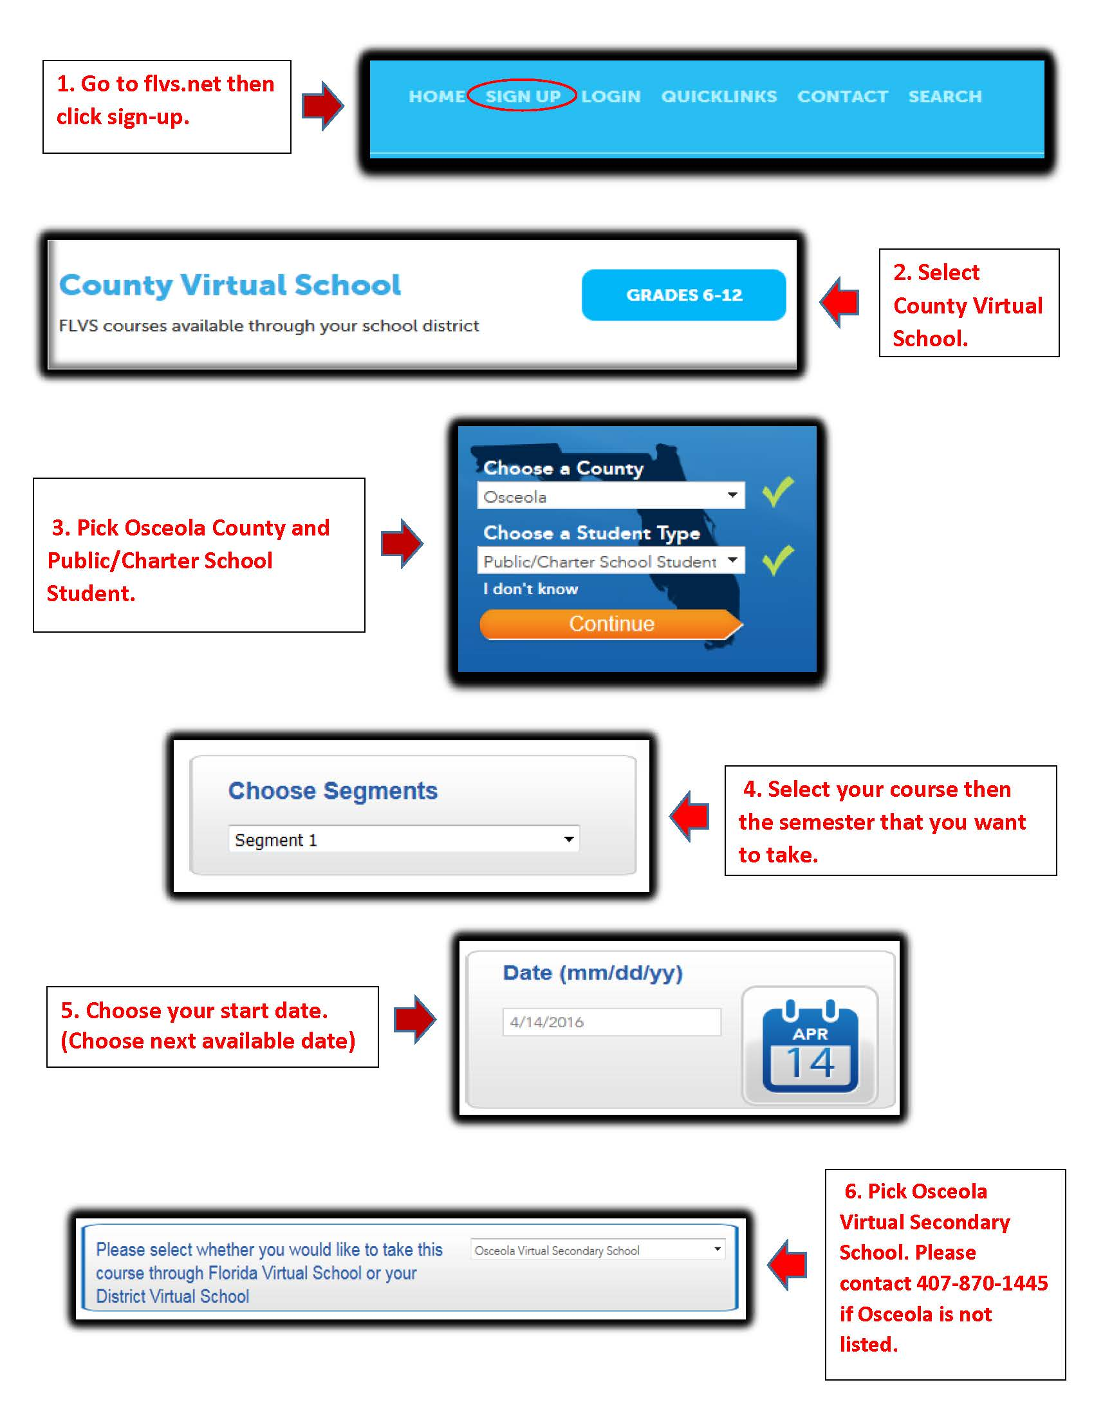
Osceola Virtual School
Some popular options:
Driver’s Education
Peer Counseling
HOPE
Students must speak to their School Counselor for approval when signing up for a class.
Only courses that are NOT offered at PATHS will be approved for OVS (HOPE is the exception)

Slide 9
College Dual-Enrollment
Take college classes FOR FREE! Including tuition and textbooks!
Replace your high school courses with college classes!
Qualifying Requirements:
*Second Semester 9th grader or older and only New Student Exp for 9th graders* (9th and 10th take full PATHS classes plus a DE if desired)
GPA 3.0 or higher
Take and pass all three sections of PERT Exam
Complete entire Valencia DE application correctly
DE application Window: TBD (October 2024)
Next PERT Exam: TBD (September 2024)
– Application window and PERT testing is available each semester at PATHS. See your counselor or pay attention to school announcements / Remind for important information.

Slide 10
Career Dual-Enrollment
Career Certification Programs for FREE!!!
Considerations for Career Program Eligibility:
High GPA
Passing Graduation Test Requirements
Good Attendance
Discipline History
Current Status of Graduation Requirements
Career Program Selection Process: 10th Grade Year
For Program Information:
Osceola Technical College (oTECH) / Homepage (osceolaschools.net)

Slide 11
Community Service Hours
Volunteer hours are NOT required for graduation, but they are HIGHLY recommended.
Can include assisting at non-profit organizations/charities during student’s own time including after school and weekends.
Bright Futures Volunteer Service Packet needed
Site/Proposal must be approved by student’s counselor.
NEW! Students are now able to turn in paid work hours (with paycheck stubs) to replace community service hours.

Slide 12
Community Service Opportunities (some examples)
Community Service for
Florida Bright Futures Scholarship
COMMUNITY SERVICE is defined as identifying a social issue in the community. This requires students to look beyond themselves and reach out to an issue faced by our society today (i.e. poverty, abuse, elderly rights, etc.). These hours will meet the requirement for the Bright Futures scholarships.
Goodwill Industries
Habitat for Humanity
Humane Society
Make a Wish Foundation
March of Dimes
Gift for Teaching
Give Kids the World
Elementary & Middle Schools
Big Brother/Sister
American Red Cross
Florida Academic Scholarship – 100 hours
Florida Medallion Scholarship – 75 hours
Florida Gold Seal Vocational Scholarship – 30 hours
Florida Gold Seal CAPE Scholarship – 30 hours
See your School Counselor for a community service proposal or visit our school website at https://www.osceolaschools.net/Page/8177

Slide 13
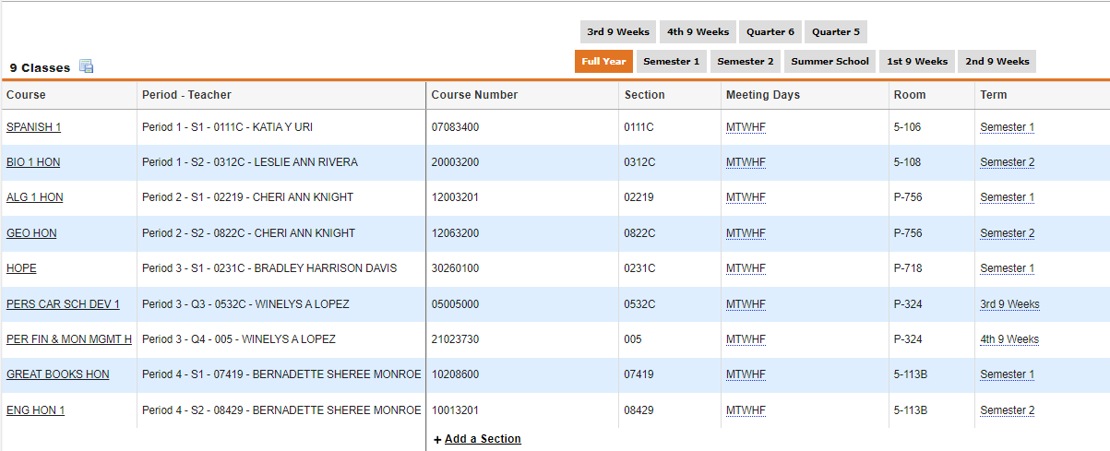
How to read your schedule in focus

Slide 14
Change your schedule view with tabs

Slide 15
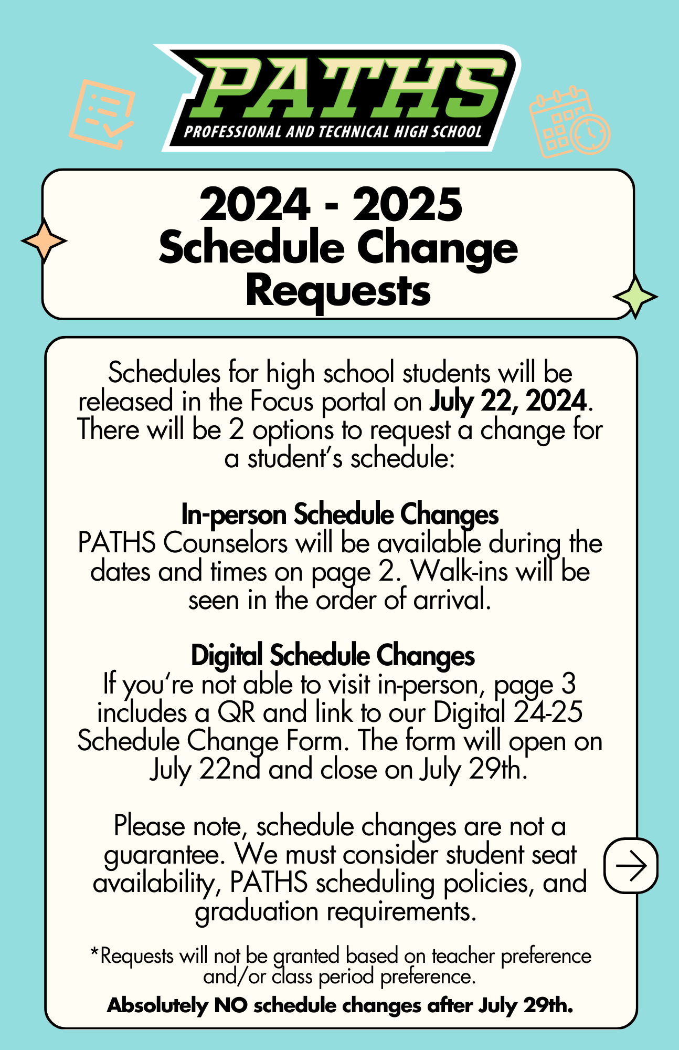
Need a schedule change?

Slide 16
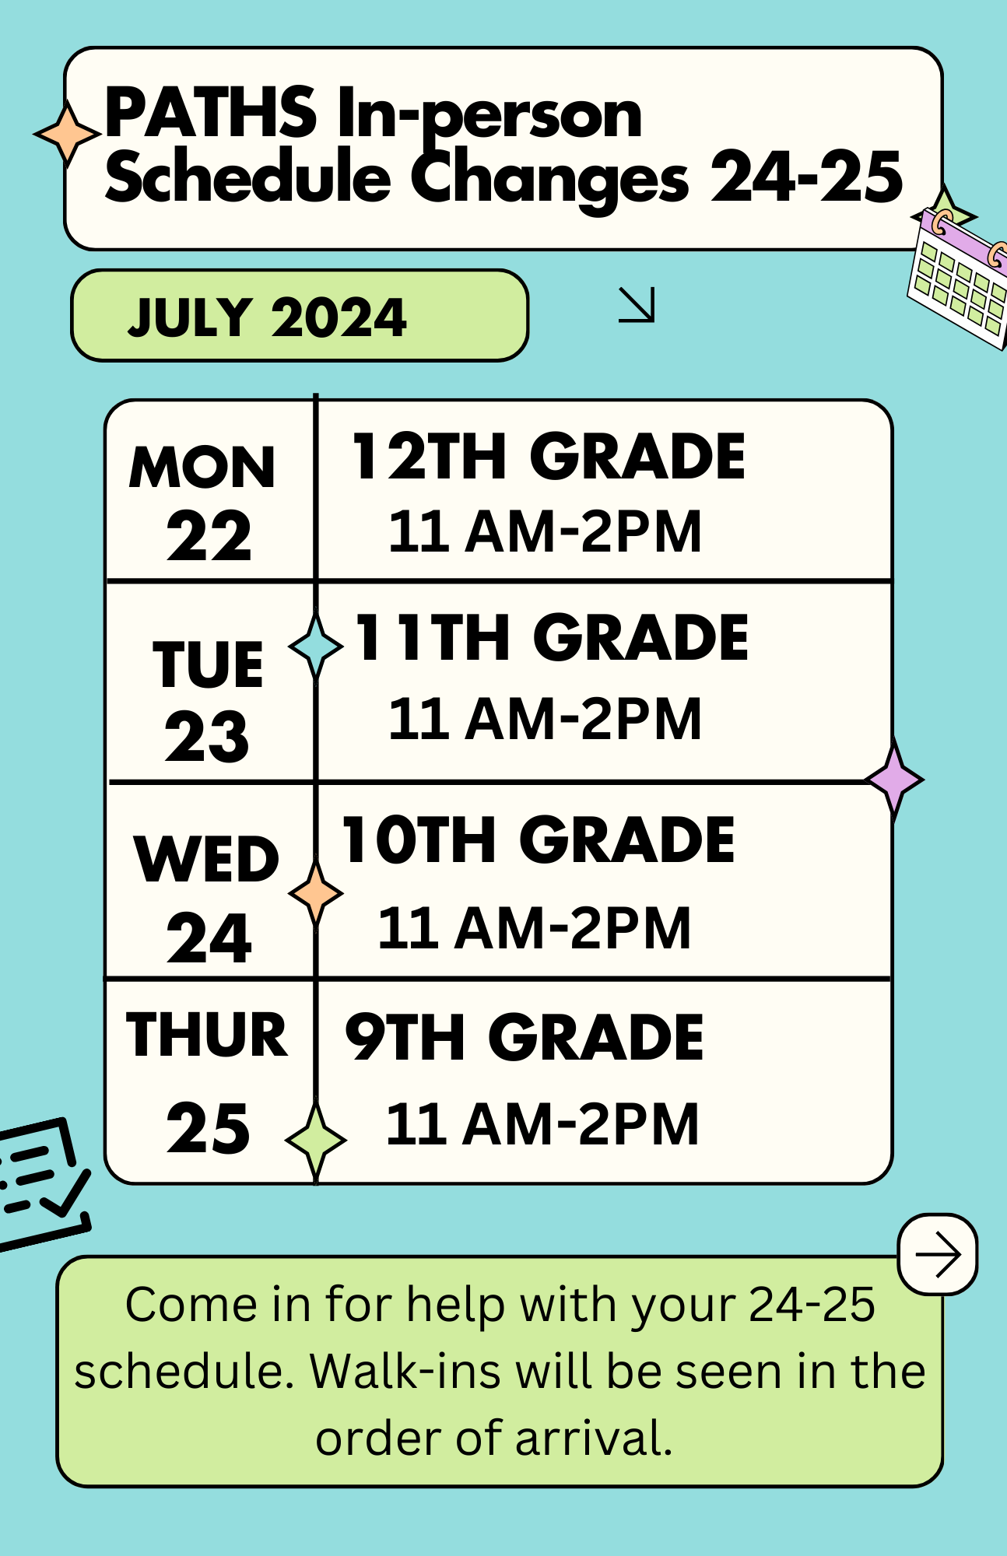
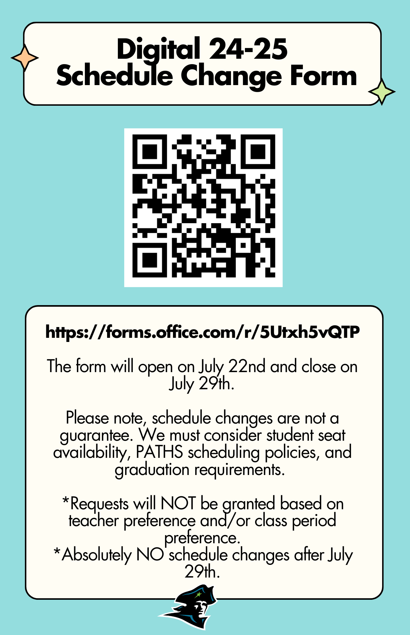

Slide 17
SCHEDULING CONSIDERATIONS
English 1, II, III, IV are Graduation Requirements
English 1 is attached to Great Books or AICE
English II is attached to American Literature
YOU ARE ATTENDING PATHS TO ACCELERATE
TAKE CHALLENGING RIGOROUS COURSES
COMPLETE A TECHNICAL PROGRAM
WORK TOWARDS OR COMPLETE YOUR ASSOCIATES DEGREE
Electives and courses are assigned by test scores in some cases
Example: All 9th graders who scored a 4 or 5 on their ELA State Test are automatically placed in AICE General Paper and Advanced Placement Human Geography

Slide 18
ADVANCED PLACEMENT COURSES
AP HUMAN GEOGRAPHY
AP COMPUTER SCIENCE
AP SPANISH LIT
AP SPANISH
AP BIOLOGY
AP PRE-CALCULUS
AP STATISTICS
AICE PSYCHOLOGY
AICE GENERAL PAPER
AP LITERATURE

Slide 19
Academic monitoring & paths student contract
PATHS staff meet consistently to review and discuss student progress and patterns and determine how to best support our students
Monitoring of academic data, discipline records, attendance data, etc.
Input from multiple levels of leadership, coaches, counselors, teachers, etc.
Types of support: Interventions, mentoring programs, tutoring schedules, academic support within the classroom, and more
Tutoring Schedule:
*Students must arrive to tutoring by 10:05 (after that, students will not be allowed in)
*Teachers may assign mandatory tutoring from 10:05-10:30
*In January, Admin assigns mandatory tutoring for ELA and Math based on progress monitoring

Slide 20
Students are placed on a contract for: low grades/lack of effort discipline issues poor attendance *one missed day is like missing 2 days at paths due to our accelerated schedule *oTECH operates on clock hours
Probationary contracts

Slide 21
Student Services Information
New patriot
Summer Orientation

Slide 22
What if I arrive at school before 6:40am?
Bus Loop gates will open at 6:40am and students may go to the Cafeteria or the outdoor patio area. Bus Drop Off is behind oTECH.
The PATHS front office doors will allow car riders to enter the building at 6:40am so that students may go directly to the Cafeteria or the outdoor patio area.
No students are allowed to go to their locker, go to any classrooms, visit the PATHS bathroom, or hang around in the PATHS hallways before 6:55am.
There are restrooms in the cafeteria for morning use

Slide 23
FACILITIES UPDATE
SECURE LOBBY
TEMPORARY PORTABLES
PORTABLES INSTALLED TO THE LEFT OF MAIN BUILDING

Slide 24
If I am a car rider?
You will be dropped off in front of the PATHS office and go directly to café/patio
2 lines of cars as you enter the PATHS Loop for drop off and pick up
5 time Grace period for Tardy to School due to construction traffic

Slide 25
Dress Code and expectations

Slide 26
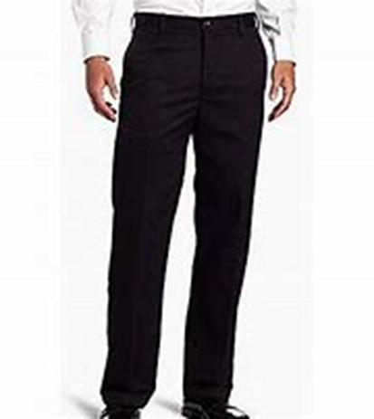
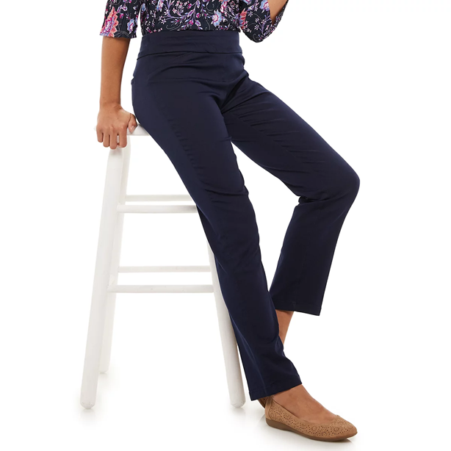
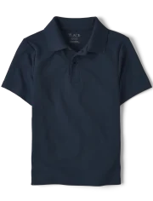
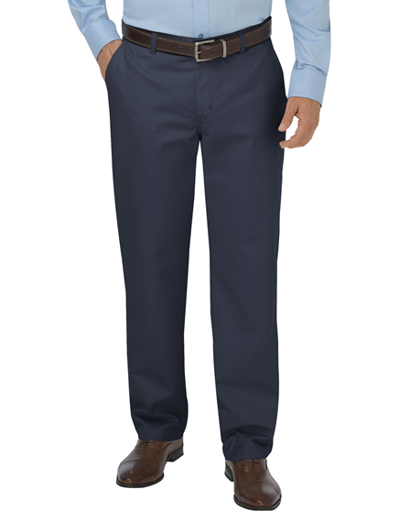
PATHS uniform polo –black, grey, green, blue white
Black, blue or khaki pants
Black, blue or khaki skirt
Black jeans (no rips or holes)
Tennis or Dress Shoes
WHAT IS NOT ALLOWED:
Crocs, flip flops or slides
Shorts
oTECH uniform is worn in 11th and 12th

Slide 27
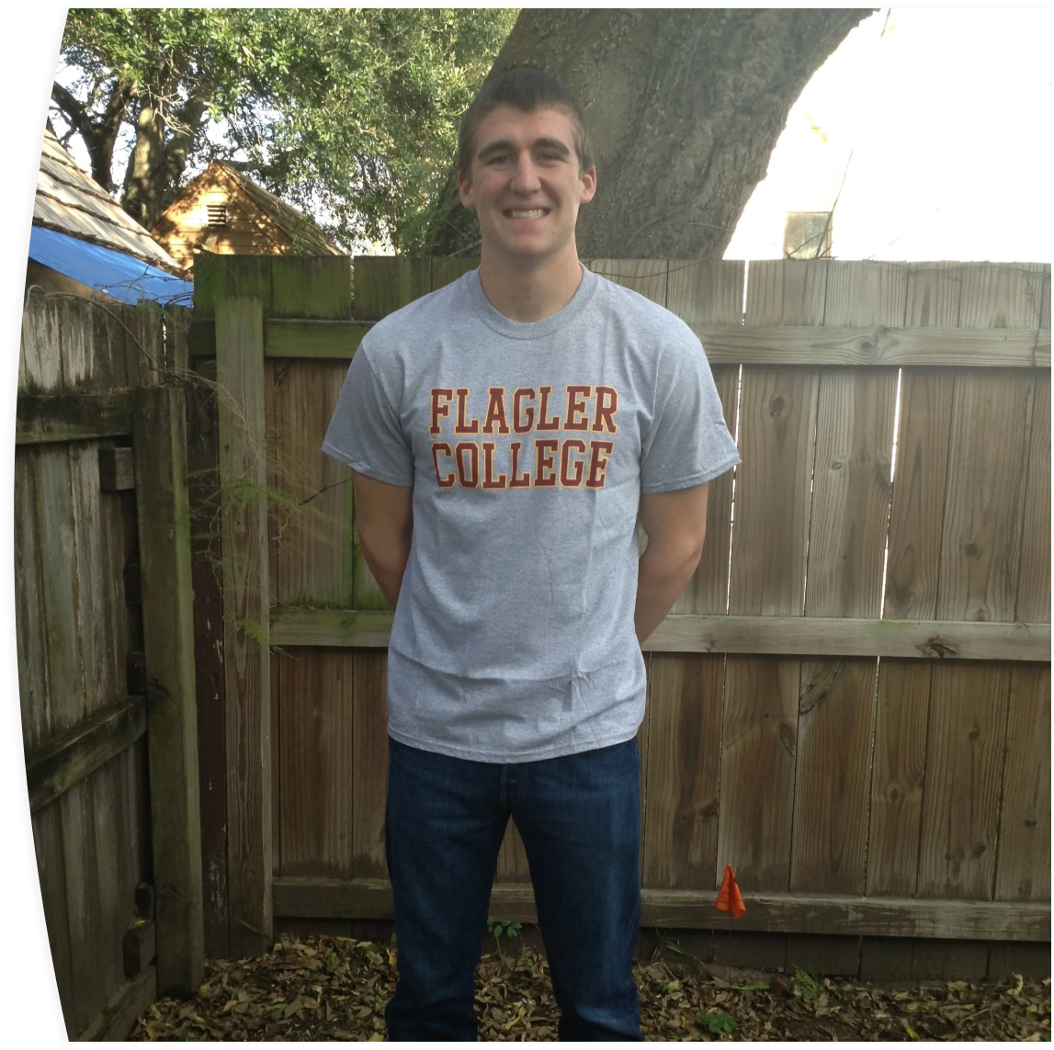
Blue jeans (no rips or holes)
School approved Spirit Shirt – 2024-2025 Spirit Shirts have been purchased and all students will receive one the first week of school.
College or Military shirt

Slide 28
What you wear will need to be ALWAYS halfway or fully open to show your uniform polo.
All hoodies must have a zipper unless it is a school hoodie!

Slide 29
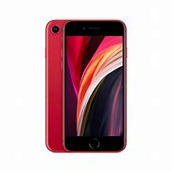
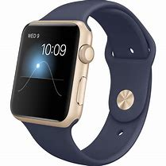
No Cell phones, headphones, and smart watches in use 7:05-2:00
All cell phones, headphones, and smart watches go in backpacks and all backpacks are placed in the designated area of the classroom. No phones allowed in bathroom, cafeteria or hallways.
1st offence – student may pick up item at end of day
2nd offence – parent must pick up item from office
Progressive Discipline on 3rd offence

Slide 30
Where may I go during lunch every day EXCEPT Wednesday?
Cafeteria
Media Center
Patio area with picnic tables
Gazebo after 10:30am
Basketball court after 10:30am
Grassy areas on the side and front of the basketball court after 10:30am
Teacher’s classrooms FOR TUTORING 10:05-10:30 or Club Meetings 10:30-11

Slide 31
To ensure the safety of everyone on campus, you must have your school issued ID visible at all times: * worn on a lanyard around your neck * clipped to your shirt
Wear it with Patriot PRIDE.
It should not be in your...
Pocket
Backpack
Wallet
No sticker over face

Slide 32
What if I forgot my ID?
If you forgot it at home, you will go to the office and get a temporary ID tag for the day
If you lost your ID, you may request a new one during lunch

Slide 33
“WIN” (What I need) Wednesday/ Intervention
During lunch on wednesday, students can get extra help/tutoring in any class.

Slide 34
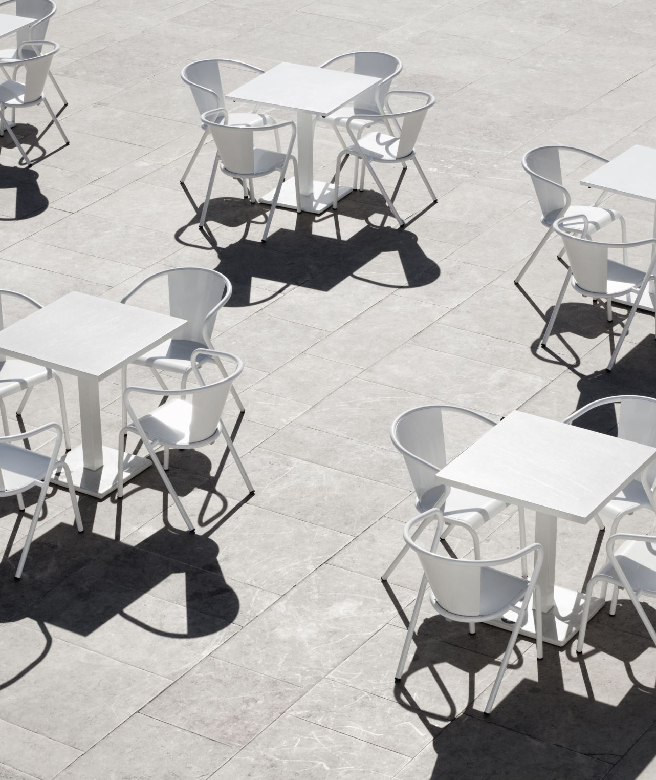
Where may I go during lunch on Win Wednesday?
The cafeteria
The patio picnic tables
Teacher’s classroom for extra help by 10:05
One grade level wins use of the sports areas for best attendance or fewest tardies

Slide 35
Get involved!

Slide 36
Paths students may play sports for:
Gateway HS athletes may board a bus and go directly from PATHS to Gateway (one bus stop away). The Dean must be notified at least two weeks in advance so that you will be assigned a bus going to Gateway High School.
Home Zone High School Athletes must coordinate bus transportation with the Dean of PATHS well in advance. This takes approximately two weeks to coordinate bus transportation.
Gateway High School
Home Zone School
Any High School

Slide 37
Clubs & Extracurricular Activities
AP Ambassadors
Battle of the Books
Black Student Union(BSU)
Comedy Club
Debate Club
Domino Club
Interact Club
Gaming Club
The Green Team
Hispanic Honor Society
HOPE Ambassadors
HOSA
Imprint Club
Knitting and Crochet
Math Club
Media Center Krew
National Technical Honor Society(NTHS)
Red Cross Club
SkillsUSA
Student Announcements
Student Government/Class Councils
Yearbook
Women's Empowerment Club

Slide 38
Get inolved!
PBIS ACTIVITIES
FESTIVALS
GAME DAYS
PBIS STORE
SPORTS TOURNAMENTS
ATTENDANCE REWARDS
STAR PATRIOT
GUEST SPEAKERS
SPIRIT WEEKS
COLLEGE FIELD TRIPS

Slide 39
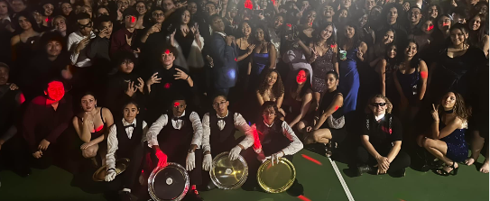
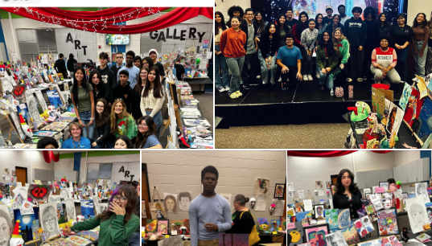
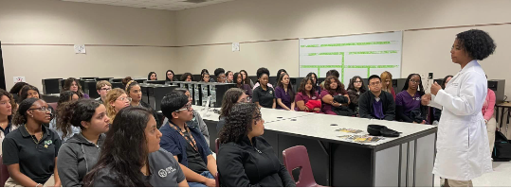

Slide 40
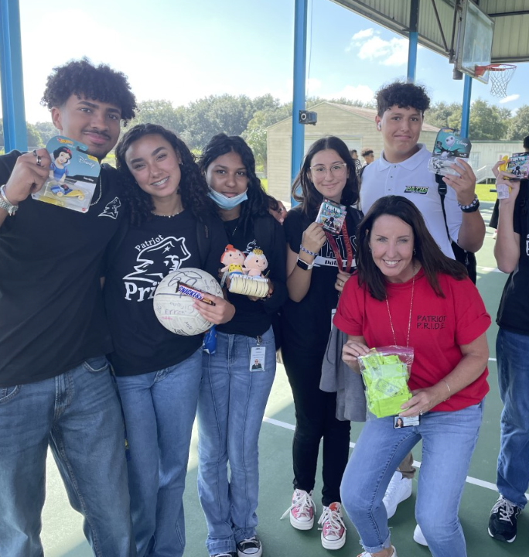
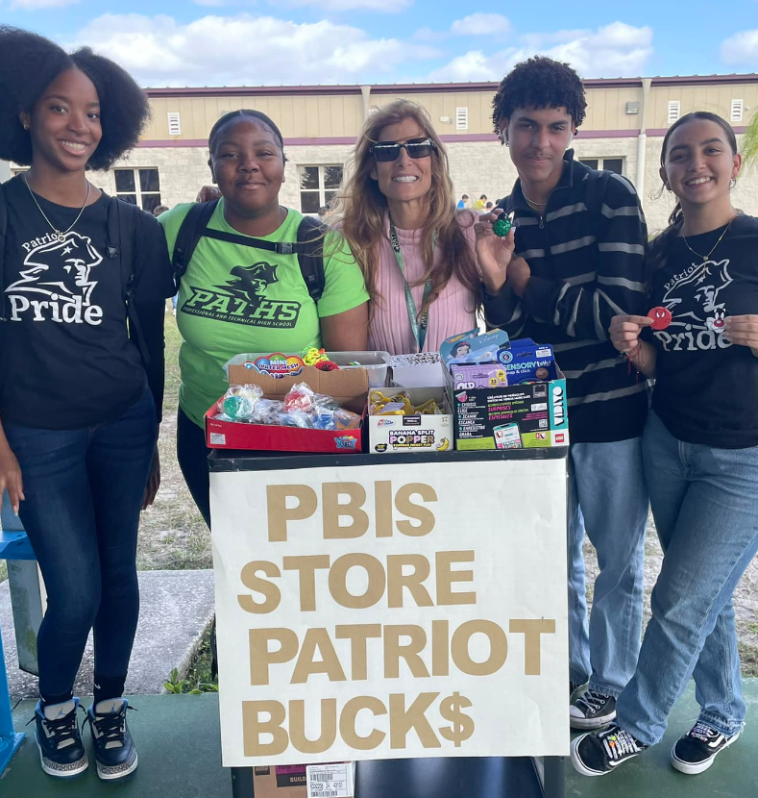

Slide 41
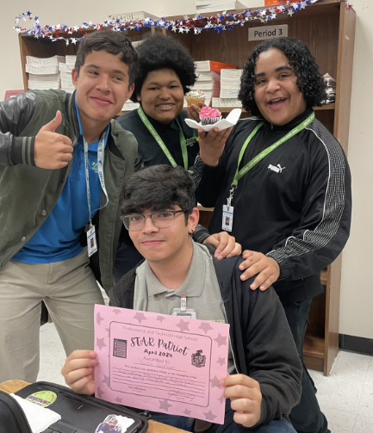
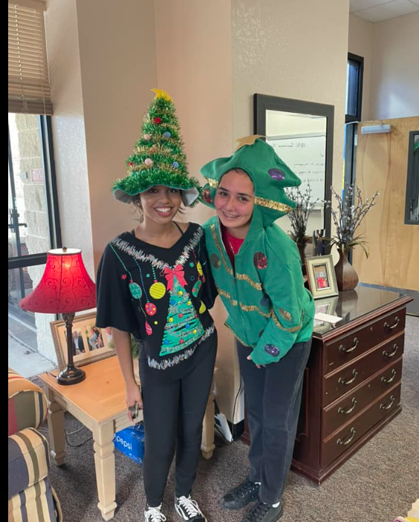
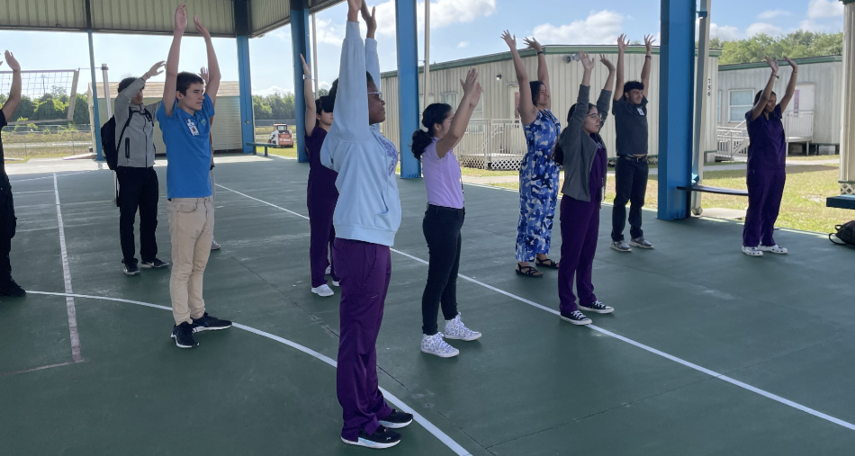

Slide 42
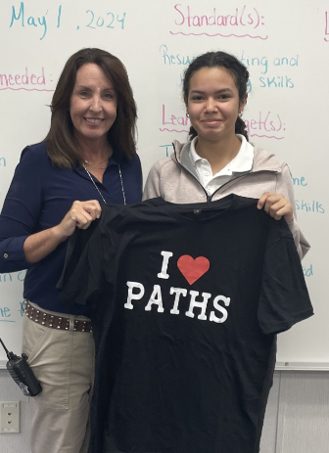
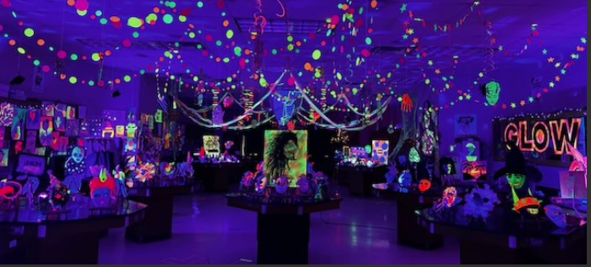
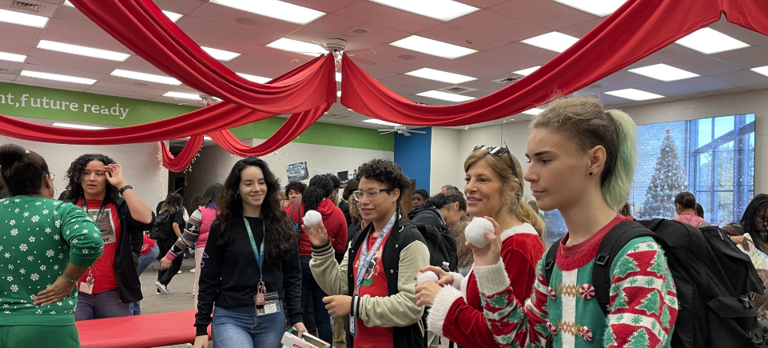

Slide 44
Purchasing polos
Available in the front office
July 8th – Aug 1st
Monday – Thursday 9 am – 12 pm
And
Meet the Teacher on August 7th 3:30-5:30
Cash or Check only

Slide 45
Today:
Students go outside with counselors to get to know each other
Parents remain for a question and answer session with administration
Take school ID photo in the cafeteria
Receive instructions on parent portal and device form

Slide 46
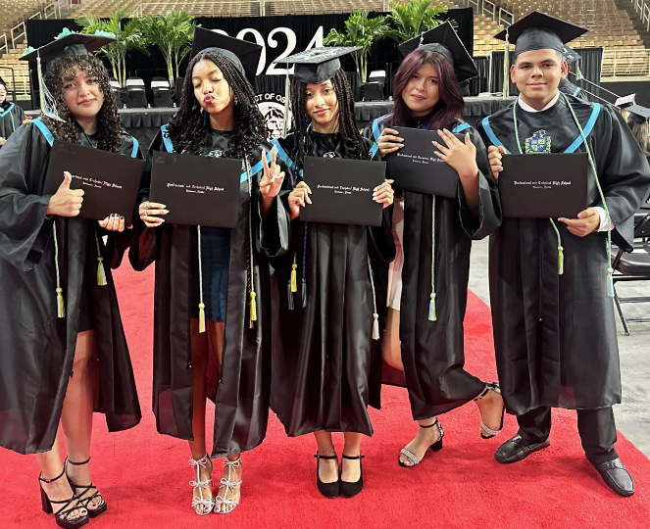
Thank you for attending our freshman orientation

